Slide 1
Interventions, Services, Supports and Accommodations for Individuals with Autism to enhance Competitive Integrated Employment (CIE) outcomes
Mary J. Baker-Ericzen, PhD
Research Scientist
WINTAC
Interwork Institute
San Diego State University
Notes:
Hello everyone. I’m Dr. Mary Baker-Ericzen. I am a member of the WINTAC team and research scientist at the Interwork Institute at SDSU. I am also a clinical psychologist who specializes in both research and practice with youth and adults with autism spectrum conditions.
Now the topic of addressing the CIE outcomes of individuals with autism spectrum conditions is not a new topic. There have been a number of previous efforts directed on this topic over past decade including SEDL’s (originally Southwest Educational Development Laboratory and now merged with AIR) initiative on
Vocational Rehabilitation Service Models for Individuals with Autism Spectrum Disorders that took place back around 2009-2012. Even then attention was placed on reviewing innovative autism employment programs in order to make designations of which are Effective Programs.
More recently (around 2017-2020) KTER Center- stands for Knowledge Translation for Employment Research has an Autism Technical Working Group

Slide 2
Agenda
Quick overview of data on employment in individuals with Autism Spectrum Diagnoses (ASD)
Current state of VR services and ASD
Review of common accommodations for ASD
Description of top evidence-based practices that have been tested within VR service settings
Virtual Reality Interview training
SUCCESS
ACCESS
Project SEARCH
Notes:
This webinar is particularly focused on research tested interventions that will be described as evidence-based practices for individuals with ASD in VR services. Many of these practices can be used for other non-ASD populations as well but these 4 practices all have in common is that all have been empirically tested specifically with ASD folks and within the VR service sector
We will start off with a quick overview of data on the employment of individuals with autism as well as typical offerings of services and accommodations for this population. Friendly reminder that this is the 4th webinar in a special series all focused on understanding and working with ASD population within VR services available on the WINTAC website. I recommend you view the other previously recorded webinars as well.
I also wanted to state that there is appreciation for both person-first and identity-first language in this population so I will be interchanging use of terms as Autism Spectrum condition, Autism Spectrum Diagnoses or ASD and autistic. Autism Spectrum in this talk today will include those who identify with autism, Asperger’s and Pervasive developmental disorder as well Aspie and Autistic (and respecting those who do not consider it as a disorder or even a condition but rather a personality trait). So to be respectful to all, multiple terms will be used interchangeably.

Slide 3
Major Themes Identified by Adults With ASD
Focus groups with autistic adults revealed the following themes:
Desire to be treated as an individual
Vocational aspirations extend beyond technologically oriented occupations
Have patience with the vocational process
Educate employers about behaviors
Request for continued support once a job is obtained
Employment can happen without VR assistance
Notes:
To start off I wanted to share some data from The Knowledge Translation for Employment Research (KTER) Center (http://www.kter.org) at American Institutes for Research (AIR) is funded to test, in vocational rehabilitation (VR) agency settings, a knowledge broker model in which individuals are positioned to bridge the worlds of research and practice. They conducted a series of focus groups a few years ago.
As spoke about in webinar 1 in this series there is large variation across each area of strengths and weakness within the autism population (hence name spectrum) and it’s important to integrate in all aspects within VR services.
Employment in STEM fields has received much press recently as a match for strengths within autistic community. However, this is not a global match and many individuals have no interest in these fields as well. Some want to have social based positions, education or public service positions etc.
Research is showing that this population takes more time. VR consumers with autism reported feeling pressured by VR to fill a position so they could claim a success, rather than target employment that was a good fit and would last beyond 90 days
Adults with ASD in this focus group reported success when their bosses and coworkers understood the idiosyncrasies with how ASD manifests. Provide resources to employers like those available at Job Accommodation Network (https://askjan.org).
Support for issues that arise . More challenging when it’s past the 90days but necessary for long-term job sustainment.
adults often felt that their VR counselors ignored or did not listen to them, or that the counselors did not find them employment that matched their interests or abilities.

Slide 4
Major Themes Identified by VR Counselors
Focus groups with vocational rehabilitation counselors revealed the following themes:
Customize strategies
Building rapport is critical
Understand a person’s interests, strengths, and weaknesses
Consistent themes across participants in the focus groups
Notes:
Same group of researchers conducted focus groups with VR counselors as well. These were the identified themes:
1. VR counselors stressed the importance of a needs assessment in developing customized strategies. In the 3rd webinar in this series we discussed methods for customizing assessment and IPE process. I will present a specific model, ACCESS later in this webinar for customized employment model.
2. the importance of building rapport and trust with the employer and other staff for the success of the employee within an organization and having candid discussions.
3.Truly understanding takes time AND gathering information from lots of people.
4. Interestingly the VR counselors agreed with themes of autistic participants even when it was negative statements of services. The VR counselors in these focus groups clearly understand the needs of adults with ASD, even if they may not always be able to fulfill them. Maybe due to agency stressors of resources stretched too thin or due to existing policies (like closing case after 90 days of employment).

Slide 5
Shocking News About Autistic Population Employment
Notes:
A quick review of the dire situation that has motivated us all to be in this webinar.
This graph shows how the poor employment outcomes for autistic adults has maintained the same for the past decade and beyond. Only about 16% are in full-time paid work. We also have learned that many with jobs are under-employed meaning they might be in jobs that are below the optimal capacity or not linked to their talents and abilities.
It is time for us all to focus on these issues and be change agents to once and for all to change these figures!

Slide 6
Autistic Population Post High School Statistics
Notes:
These images taken from the amazing work done at the Drexel institute examining service systems data shows that autistic adults have poor outcomes in a number of areas.
READ data on slide.

Slide 7
Autistic Population Employment Outcomes
Notes:
Drexel’s Autism research program also delved deeper into the data available in the 9-11 dataset from the VR system. Found that…
READ data from slide.

Slide 8
Autistic Population Life Outcomes
Notes:
Again from Drexel University Autism research center we see very similar outcomes for the adult population as was presented for TAY.
READ Data from slide.

Slide 9
General Services and Supports for CIE
Supported Employment- Job Development, Job Coaching
Customized Employment-
Training Services- Personal, Vocational, Social Adjustment and Work Adjustment
Pre-Employment Transition Services
Notes:
As most of you know there are 2 main services provided by VR in support of CIE- competitive Integrated Employment along with training services such as Personal, vocational and Social Adjustment and work adjustment services. The following evidence-based interventions that were chosen to be presented are delivered within 1 or more of these funded programs for adults with autism along with TAY within Pre-Employment Transition Services. Two the programs virtual interview training and SUCCESS have developed separate versions for TAY and Project SEARCH has focused on TAY population.
2 of the
1) Supported Employment

Slide 10
Accommodations for CIE
Simplified instructions using multi-modal delivery
Clear expectations
Modeled training
Reminder systems
Regular and Ongoing feedback (positive and constructive)
Consistent schedules
“Check ins” providing reassurance
Organizing job tasks and use of systems (checklists, timers, alarms, task analyses)
Notes:
Let’s first go through accommodations for autistic adults and TAY that have found to be important to embed into all evidence-based practices and services.
-Providing simplified instructions and delivering the instructions in multimodel fashion such as given verbally along with written or visual (images).
Providing clear expectations that give details and attend to the potential of literal interpretation
When training on a new skill or process to model it and allow the individual to observe how it is done
Guide the use of reminder systems including those available on phone to remind when to be at work, when to complete tasks or when deadlines are coming up
Provide regular feedback that informs both what is being done correctly and going well AND what needs to be done differently and why
Provide consistent schedule both at work but also for meetings
Create check ins into their work schedule and existing meetings and create an environment for them to ask questions and share how feelings
Last to embed in support systems that include use of checklists-tasklists, timers/alarms, etc.

Slide 11
Reasonable and Common Job Accommodations
Pictures or drawings of the task
Templates of forms or documents
A note taker
A voice recorder
Written instructions
Daily checklists
Written or verbal reminders
Written or picture instructions next to machines, such as postage machine, copier, printer
Minimal clutter in the work environment
Minimal noise in the work environment (such as no radios or music)
Large tasks broken down into small steps
A “Where to” guide for coworker support
A timer or alarm as a reminder
Additional hands-on training
Headset for telephone or a speaker phone
Multiple breaks
Performance feedback presented visually (charts, diagrams)
Mentor or job coach
Information for coworkers about ASD His own desk or workspace
Checklist for completing task
Timelines for completion of task
Assignment of one task at a time
Training on appropriate workplace behaviors (e.g., interacting with customers)
Notice before changes (such as rearranging supply closet or change in job related work)
Consistent supervision by one person Prioritization of tasks
Regular feedback on performance (positive and constructive)
Transition to Work: Accommodations for Students with Autism-- List of Reasonable and Common Job Accommodations - 2007, M. Rosenshein, Ohio Center for Autism and Low Incidence (OCALI).
Notes:
Such accommodations have been discussed through out this series of webinars in working with individual with autism in VR system so please review prior webinars if you haven’t already all available at WINTAC. This is a quick review of those that can be particularly helpful for employers to do at the worksite. Remember that more is not always better when it comes to accommodations so it’s important to fit the specific accommodations to the needs of the individual.

Slide 12
Evidence-Based Practices
VR-JIT- Virtual Reality Job Interview Training: Adult & TAY versions (Dr. Matthew Smith, PhD., LCSW
http://leveluplab.org/
SUCCESS- Supported, Comprehensive Cognitive Enhancement and Social Skills: Adult & TAY versions (Dr. Mary Baker-Ericzen, PhD, San Diego State University)
http://interwork.sdsu.edu/main/programs
ACCESS- Achieving Competitive, Customized Employment through Specialized Services (Dr. Tammy Jorgensen Smith, Ph.D., CRC, University of South Florida)
http://www.usf.edu/cbcs/cfs/academics/rmhc
Project SEARCH + ASD supports- (Paul Wehman & Carol Schall et al, Virginia Commonwealth University’s Rehabilitation Research and Training Center -VCU-RRTC)
https://vcurrtc.org/index.cfm
https://vcurrtc.org/deployed2work/

Slide 13
VR- JIT Virtual Reality Job Interview Training
Matthew Smith, PhD, LCSW
University of Michigan
School of Social Work
Notes:
Funded by NIMH SIBR grant

Slide 14
Virtual Reality Job Interview Training (VR-JIT)
R44 MH080496
Notes:
To help fill this gap in evidenced-based practice, Dr. Smith’s team along with SIMmersion LLC developed virtual reality job interview training with funding from the National Institute of Mental Health. This tool originally focused on the needs of adults with severe mental illness.

Slide 15
VR-JIT Character & Training Interface
Notes:
Introduce Molly and SIMantha. The program includes a virtual interviewer- Molly for adult version and 2 different interviewers for TAY version. The VR interviewer asks the participant a series of interview questions and the participant chooses a response from a set of responses provided. The other character on the screen is a coach. The coach provides real-time feedback about the participants response and gives a reason for why it was not a good response. Participants can also use the color gauge to understand how the interview felt with their response. The program allows for viewing the interview transcript for additional information and the conversational exchange over the course of the interview.
Briefly, trainees repetitively interview with Molly Porter where they receive feedback on their statements and there progress towards performance goals. Trainees choose from 10-15 statements that range between very helpful to hurtful to rapport with Molly. At the end they get a score from 0 – 100.

Slide 16
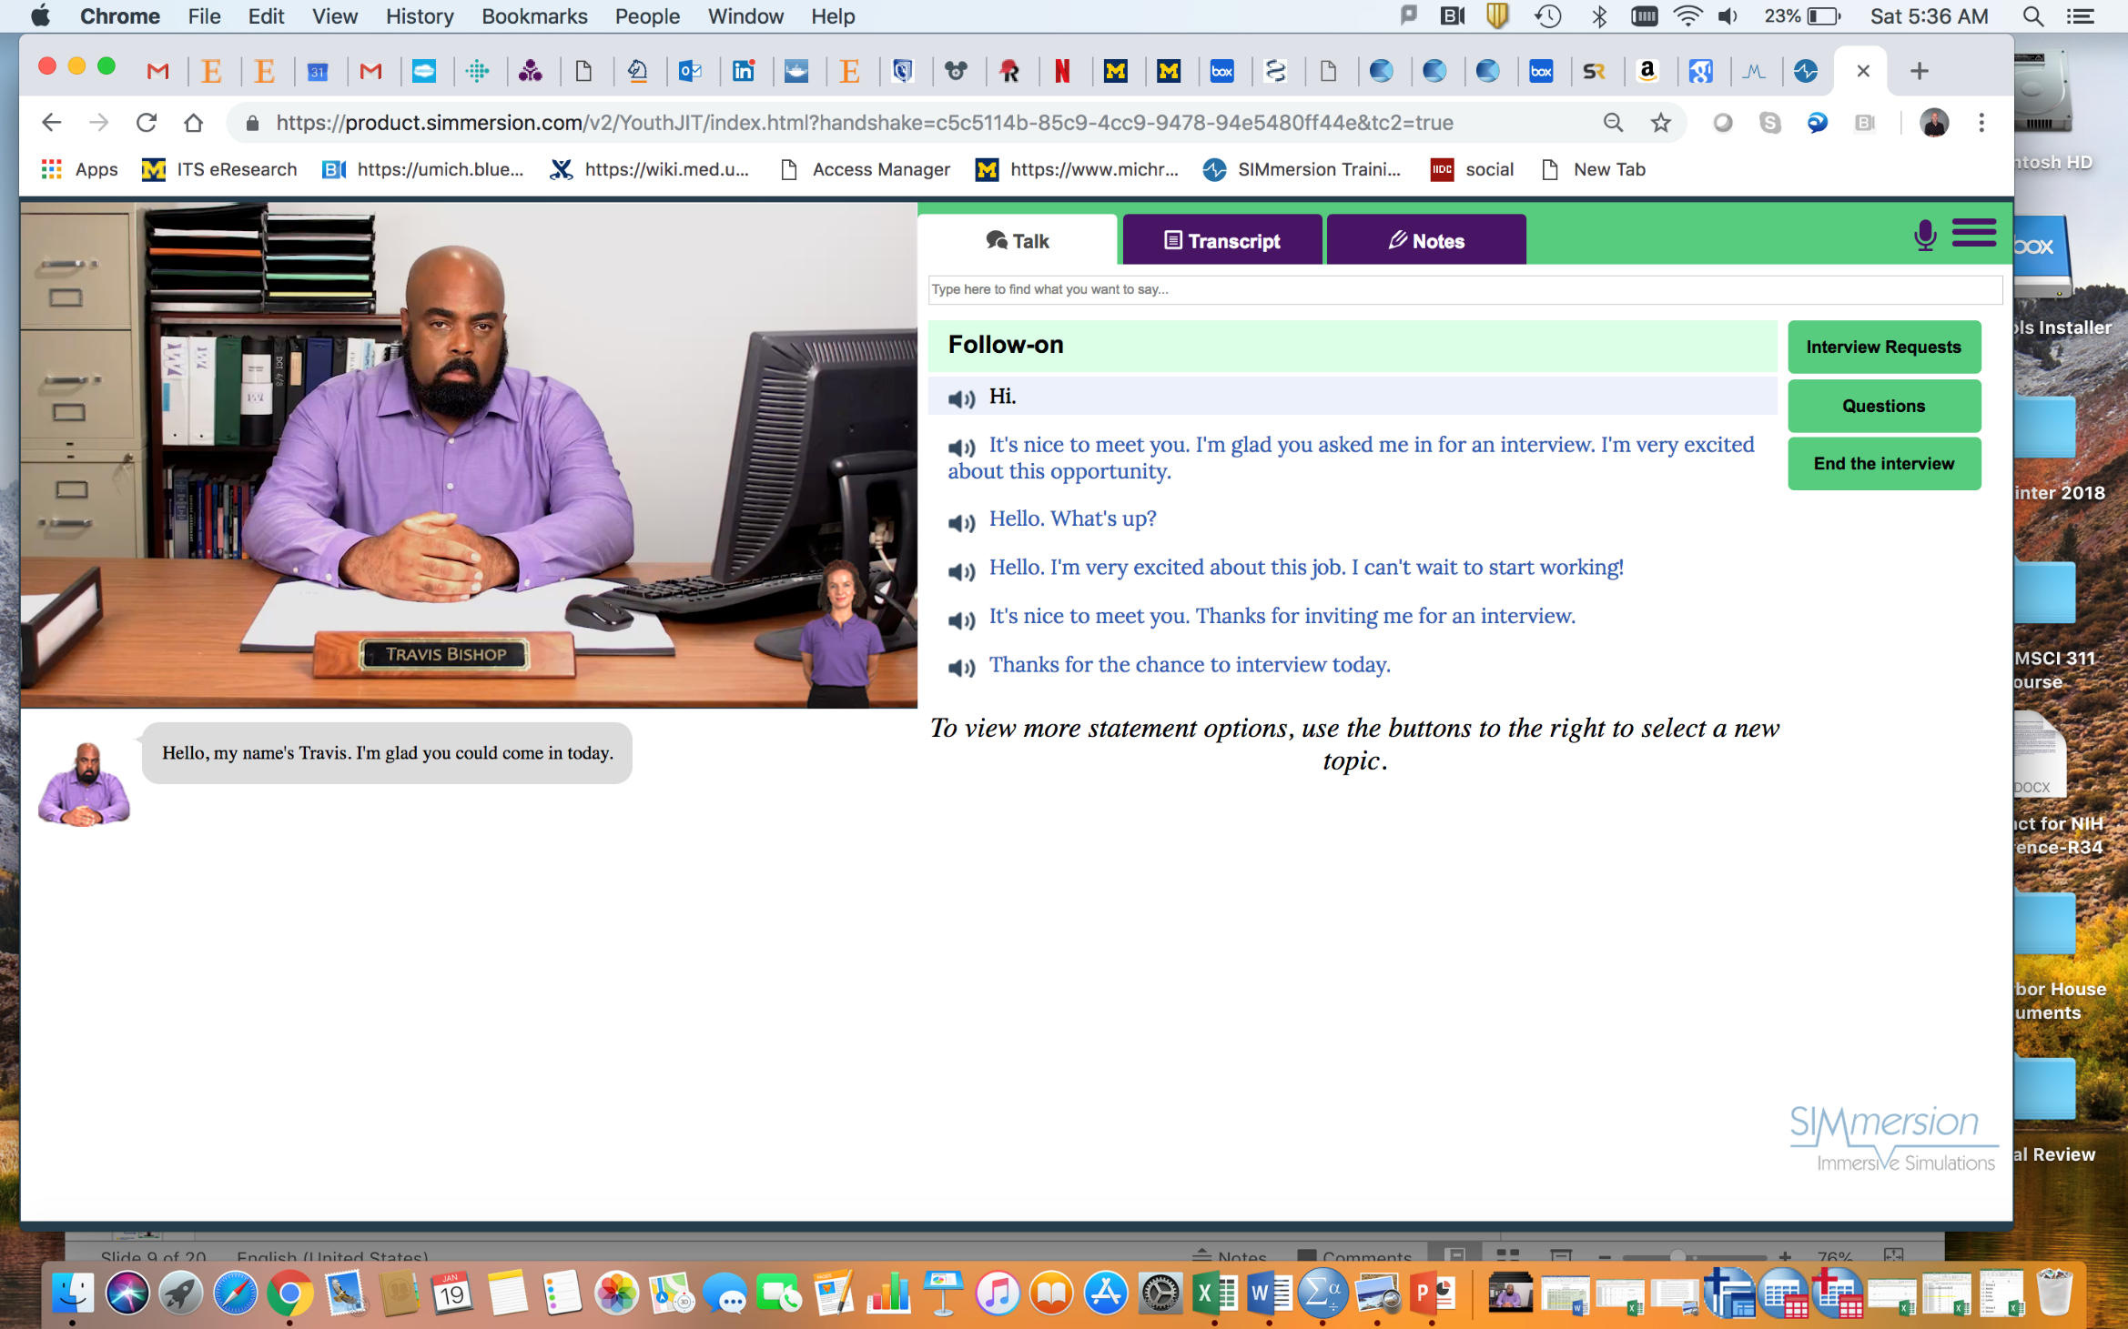
TAY version of VR-JIT II - Implement the adaptations
Notes:
This shows Travis- one of the TAY interviewers. You can also notice the coach character is more consistent with the TAY participant age.
Feedback is a key feature of the tools. There are 4 levels of feedback that trainees receive.
Trainees observe non-verbal cues to give them real-time feedback as they interact with the virtual characters.
Trainees get feedback on their specific statements via a transcript that is accessible during the interview (and afterwards).
Trainees receive individual numerical scores for each learning goal and a total score across all learning goals.
Trainees receive a detailed performance review for each learning goal. All feedback options are automated by the tools.
Each interview can take anywhere from about 10 minutes (on easier levels of difficulty) to 25 minutes (on hard levels of difficulty). For folks who read a little slower or take more time choosing their response, the interviews can take a little longer.

Slide 17
TAY Version of VR- JIT II - Implement the adaptations
Phase I findings
More social story telling
Greater scaffolding of
learning goals
Notes:
In general, the more interviews one completes, the greater improvement in their skills. That said, each trainee has their own level of skill before beginning the training. Thus, trainees with stronger skills at the start may need fewer sessions than those with fewer skills at the start. In their research they observed a ‘dose effect’ which means that the more interviews a trainee completes, the more likely they are to get a job.
In general, staff training in this model require ‘trainers’ to complete approximately 3.5 hours of training prior to their real-world implementation of the tool. This 3.5 hours is broken up into spending time attending an orientation session with our staff; using the tool themselves; and performing a series of two role-plays with a peer to practice teaching the tool to others (and serving as the student to someone else who is practicing to teach the tool).

Slide 18
Results from Adult Efficacy RCTs
Adult Efficacy RCTs
Smith et al., 2014a; 2015a; 2015b
Notes:
What we see here is that using the adult version of the tool was associated with improved skill in both groups but the ASD group clearly had additional room to improve as they were still performing below the abilities of adults with SMI.
A 45 is a perfect score

Slide 19
Results from Adult Efficacy RCTs
Rate of Offers at 6-Month Follow-up
Services as usual
VR-JIT
Trainees
Adults with SMI Young Adults with ASD
Smith et al., 2016a,b
Notes:
These are individuals who were actively job-seeking and responded to community advertisements to participate in research

Slide 20
Panel A. Likeliness to be hired Panel B. Job interview skills total score
Panel C. Job Interview Anxiety Panel D. Competitive, Integrated E Employment by 6 Months Follow-Up
pre-ETS only
Pre-ETS + VIT-TAY
Notes:
SAU Only (n=23) SAU+VIT-TAY (n=48)
0.0% pre-ETS obtained competitive jobs vs. 22.9% in pre-ETS + VIT-TAY
30% pre-ETS obtained non-competitive jobs within 6 months compared to 19% among pre-ETS + VIT-TAY
Overall employment was 30% pre-ETS only vs. 41.9% in pre-ETS + VIT-TAY

Slide 21
Results from an Open Trial of VIT-TAY in Students with Disabilities (in general)
Six Month Employment Rates Across All Participants (n=318)
Low Dose Medium Dose High Dose
1-5 Trials 6-14 Trials 15+ Trials
Notes:
Future directions for this team is Virtual Soft Skills at Work (Transition-Age Youth with Autism)
In 2020, Dr. Smith and SIMmersion, LLC, received a 5-year grant from the National Institute of Mental Health (R44 MH123359-01) to develop a computerized simulation to help transition-age youth with autism practice their soft skills in a work setting by repeatedly practicing conversations with virtual customers, coworkers, and supervisors.

Slide 22
SUCCESS: Supported employment, Comprehensive Cognitive Enhancement & Social Skills
Mary Baker-Ericzen, PhD
San Diego State University
Child & Adolescent Services Research Center- Rady Children’s Hospital
Notes:
This curriculum was developed by a research-community partnership called ACHIEVE – stands for Active Collaborative Hub for Individuals with ASD to Enhance Vocation and Education outcomes. This group includes researchers, providers, administrators, educators, family members and autistic adults and transition age youth.

Slide 23
SUCCESS
SUCCESS is a vocational “soft skills” intervention that teaches new skills and enhances existing skills in the areas of executive functioning, social cognitive and communication skills necessary to be successfully employed.
Low Vocational Soft Skills are the number one reason for job loss
Soft Skills are key deficit areas for those with autism
Notes:
The SUCCESS program was developed out of a community request for a comprehensive and relevant curriculum to enhance soft skills for autistic individuals. This community demand was based on the fact that vocational soft skills is a high reason for job loss across every industry and these skills are directly related to the autism condition in that they are considered key areas of deficit for the diagnosis.
As bullet one states- SOFT SKILLS are defined as combination of executive functioning, social cognitive and communication skills necessary to be successful at work. (hence why the evidence-based intervention is uses the acronym SUCCESS).

Slide 24
Improving Executive Functioning Cognitive Enhancement Therapy
Executive Functioning: is a term used to describe the many different cognitive processes that individuals use to control their behavior, adapt to their environment and respond to different situations . Described as higher order thinking
Cognitive Enhancement Training -Improving Executive Functioning Skills
Restorative –Rehabilitative-Habilitative (Training Brain)
Compensatory-Work arounds (Increasing Strategies)
Notes:
Sometimes these processes seem to happen in a seamless and automatic way, and at other times they seem to not happen quickly enough (or not at all), resulting in what some people refer to as “getting stuck,” not knowing what went wrong and having a hard time discerning what to do next.
Two approaches towards cognitive training studies have been taken, compensatory and restorative. Compensatory training approaches teach new ways to accomplish a cognitive task by working around cognitive weaknesses or deficits. This is done by training strategies such as categorizing or visualizing information that is to be remembered, as well as utilizing external memory aids such as notes, calendars or other environmental cues.^{[43]} Restorative approaches seek to strengthen specific cognitive domains in order to improve functional performance more generally. For example, participants of some studies practice memory and attention games with the hope of improving those domains in general. The idea behind restorative training is that training on one task might enhance the cognitive ability or abilities that are needed to perform similar tasks (near transfer) or very different tasks such as activities of daily living (far transfer). Whereas compensatory approaches tend to only produce near transfer effects by benefiting the specific training task or domain that was targeted by the training program, far transfer effects through restorative training are considered the 'holy grail' because they suggest cognitive functions can be enhanced beyond the specific domain of training. To date the training studies that have been conducted have used either compensatory or restorative (or both) types of approaches to assess the impact of cognitive training on brain health.
At its best, executive functioning allows us to be mentally and behaviorally flexible to all sorts of task demands, to adjust our thinking to accomplish our goal (even when there are changing conditions along the way) and to adapt our reflexes and responses in ways that result in coherence and smoothness of responses.

Slide 25
Executive Functioning Package of Cognitive Skills
Sustained Attention: “sticking to it”
Inhibition: “look before leaping”
Learning & Memory: “wheels are turning”, “remember when”
Cognitive Shifting: “see the forest for the trees”
Cognitive Flexibility: “go with the flow”
Problem-solving: “think outside the box”
Contextual Awareness: “don’t judge a book by it’s cover”
Goal-Oriented Thinking: “can’t build Rome in a day”
Prospective Memory: “don’t forget to remember”
Notes:
In order for everyone to be on the same page about what the cognitive skills are that are typically included under the umbrella term Executive Functioning and to understand the comprehensive nature of SUCCESS. Here is a list of the individual cognitive constructs taught. Science term on left and community used phrase on right (showing that we all speak about these skills often in day to day life).
Sustaining Attention- is the ability to continue to focus on a task or stimuli over a period of time and ignore other competing inputs. It is described as “sticking to it” and not being distracted.
Inhibition- the ability to resist or not act on an inpulse and the ability to stop one’s behavior at the appropriate time. This can be described as a failure to “look before leaping”.
Working memory- is the capacity to actively hold information in mind for the purpose of organizing it to encode it, completing a task or generating a response. It is a foundational skill in carrying out multistep activities, implementing sequence of actions or following complex instructions.
Cognitive shifting- this relates to the ability to move from one thought to another or shift attention from one cue to another. Cognitive shifting is a foundational skill to abilities such as transitioning, being flexible, problem-solving , switching attention/focus and changing mindset from one topic to another.
Goal-oriented thinking- is the ability to organize thoughts to plan, prepare and create step-wise sequence to complete a task or accomplish a goal. It involves thinking ahead to anticipate future events or needs, developing steps ahead of time to carry out a task or activity and implementing instructions to reach goal. It starts with the ability to set a goal and ten strategically select the most effective method or sequenced steps to reach it. Planning often requires stringing together or purposely sequencing information or actions and gathering the materials required to successfully carry out the plan.
Prospective memory” Prospective memory refers to the ability to remember to carry out delayed intentions, more precisely, to remember to initiate and execute an intended action at some point in the future.

Slide 26
Social Cognition Training
Social cognition- the ability to think about the minds and mental states of others
Originally viewed as a sub-type of social psychology that focuses on how people process, store, and apply information about other people and social situations. Now studied by neuropsychologists as a cognitive neuroscience function.
Processes used to decode and encode the self, other people and interpersonal knowledge
Notes:
It focuses on the role that cognitive processes play in our social interactions. Area of brain responsible for social cognition is right tempero-parietal junction.

Slide 27
Social Cognitive Skills
Perspective-taking- “putting yourself in someone’s shoes”
Social awareness- “if the shoe fits wear it”
Social knowledge- “use the magic word”
Emotional awareness- “take a chill pill”
Social communication- “what’s up dog?”
Notes:
Again Social cognitions encompass a number of individual constructs grouped together. The science term on the left and the community used phrase on right.
Perspective-taking- understanding the intention, thoughts and feelings of others and being able to predict what others will do.
Social Awareness- It essentially means to be conscious or aware of the rules, culture and problems within a society or community.
Social Knowledge knowledge of both declarative and procedural processes that may be expressed and accessed both implicitly and explicitly. Declarative knowledge is characterized by facts or abstract concepts (e.g., semantic memory) about social scripts, relations, and phenomena. It has to do with what a person can state about the social world
Emotional Awareness- being able to identify emotions in self and others. Can notice them, identify what feeling
Social communication- ability to use language (syntax, semantics, and pragmatics) to interact with others in a host of situations, from entering peer groups to resolving conflicts.

Slide 28
Cognitive & Social Cognition Training: CORE COMPONENTS
1. Psychoeducation- teaching to comprehension of the construct, neuroscience terminology and neurological function
2. Experiential (failure)- notice when it is not activated and what it feels like
3. Teaching of strategies (Moves)- specific ways to “activate” brain function to be used at given time
4. Experiential (success)- notice what it’s like when turned on, explanation of how to turn on and learn ability to “turn on”,
5. Practice- Activities, role-plays, scene simulations, real-world scenarios (capture opportunities as arise)
6. Life demonstrations- assignments to complete in own life called “Try it and Apply it!”
Notes:
Can’t demonstrate it like behaviors. All internally occurring. Much more focus on experiential learning. Can’t be taught in lockstep or sequenced manner. Also is used in real-world with steps. More all or nothing type of functioning.
The more novel or complex a task or situation is the more an individual needs to use their executive functioning skills. This is problematic when an individual has executive dysfunctions.

Slide 29
SUCCESS: Table of Contents
CURRICULUM OVERVIEW
PROSPECTIVE MEMORY PART I
PROSPECTIVE MEMORY PART II
LEARNING & MEMORY PART I: Attention
LEARNING & MEMORY PART II: Encoding
LEARNING & MEMORY PART III: Encoding
LEARNING & MEMORY PART IV: Retrieval
COGNITIVE FLEXIBILITY
COGNITIVE FLEXIBILITY & PROBLEM-SOLVING
GOAL-ORIENTED THINKING
CONTEXT AWARENESS PART I
CONTEXT AWARENESS PART II
INTRODUCTION TO SOCIAL THINKING
PERSPECTIVE-TAKING & SOCIAL ACTION EVALUATIONS
REPAIR AND RECOVER
16. EMOTIONAL AWARENESS & EMOTION REGULATION
17. SOCIAL COMMUNICATION PART I
18. SOCIAL COMMUNICATION PART II
19. SOCIAL COMMUNICATION PART III
20. SEEKING, GIVING & RECEIVING COMPLIMENTS
21. SEEKING, GIVING & RECEIVING CONSTRUCTIVE CRITICISM
22. SEEKING, GIVING & RECEIVING HELP
23. SOCIAL NETWORKING
24. SELF ADVOCACY
25. SOCIAL MEDIA & ELECTRONIC COMMUNICATIONS
26. REVIEW & CELEBRATE SUCCESS
Notes:
Now it’s 26 sessions added self-advocacy meeting

Slide 30
Illustration of types of Logic Models used to teach Social Cognitive and Communication Skills

Slide 31
Study Samples
Community Open Trial SUCCESS program
Total enrollment= 100
Cohort 1= 9 * Cohort 9= 11
Cohort 2= 8 * Cohort 10=4
Cohort 3 = 11 * Cohort 11=9
Cohort 4 = 8
Cohort 5 = 12
Cohort 6 = 11
Cohort 7 = 9
Cohort 8 = 8
RCT Trial SUCCESS program; Total enrollment=39
Cohort 1= 6
Cohort 2= 8
Cohort 3= 12
Cohort 4= 13
College SUCCESS
Total Enrollment=30
UCSD=11
SDSU=6
CSUSM=5
SDCCD=8
TAY SUCCESS
Total enrollment= 31
2 High Schools
2Transition Programs
Notes:
4x increase
Over 2.5 x increase
These are also the 2 cohorts that started up without the internship component built in and without the certification

Slide 32
Executive Functioning Skills BRIEF-A
Time 1= baseline Time 2= post
Participant Report
Time 1= baseline Time 2= post
Parent Report

Slide 33
Social Cognitive & Communication Skills SRS-2
Time 1= baseline Time 2= post
Participant Report
Time 1= baseline Time 2= post
Parent Report

Slide 34
Changes in social performance and employment
Social Behaviors
Social Skills Performance Assessment (SSPA)
-An Interactive Role-Play with trained administrator coding relevant work related social behaviors
Employment setting, hrs and wages gathered at baseline and post
* Of participants who worked at both BL and Post
Control 0% received raises
Intervention 21% received raises

Slide 35
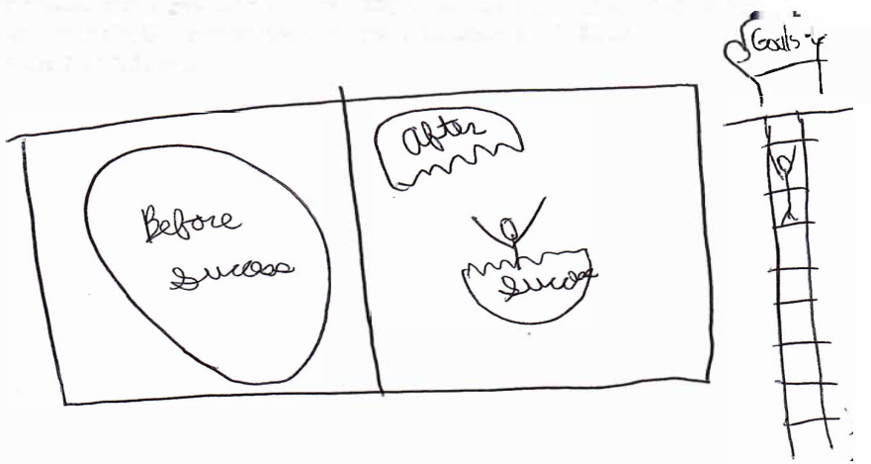
Participant Reports and Drawings
What we learned in the SUCCESS program
We learned how to act in the work place, the expected and unexpected behaviors, and self-advocate ourselves in any situation including the work place.

Slide 36
ACCESS Achieving Competitive Customized Employment through Specialized Services
Tammy Jorgensen Smith, PhD, CRC
University of South Florida- Tampa Campus
College of Behavioral and Community Sciences
Department of Child and Family Studies
Rehabilitation and Mental Health Counseling Program
Notes:
Funded by NIMH

Slide 37
Customized Employment (CE)
Defined by WIOA as:
“competitive integrated employment, for an individual with a significant disability, that is based on an individualized determination of the strengths, needs, and interests of the individual with a significant disability, designed to meet the specific abilities of the individual with a significant disability and the business needs of the employer, and carried out through flexible strategies.”
(WIOA, 2014)
Notes:
Before we go into the specifics of the ACCESS study, let’s take a moment to review the definition of customized employment. The is the definition provided in the Workforce Innovation and Opportunity Act of 2014.
Customized employment strategies include a focus on career interests and talents. We use personal and professional connections to find jobs.. However, some individuals with autism have a difficult time expressing their interests and explaining their talents. Work environments are often not designed to be sensitive to sensory issues such as temperature intolerances, noise levels, and lighting. Many employers are not focused on unique interpersonal and learning styles – not because they are not willing or able to be, but because they aren’t aware of the need to be.
Customized employment strategies open doors for people who have not been successful in achieving competitive, integrated employment goals due to the complexity of their disability. It is not a new concept or process as these strategies have been demonstrated to be successful for decades. Like many innovative approaches, it takes time to get to the point of systems change. As for customized employment, that time has come and we now have the opportunity to utilize these strategies to improve successful rehabilitation rates for VR consumers with the most complex disabilities.

Slide 38
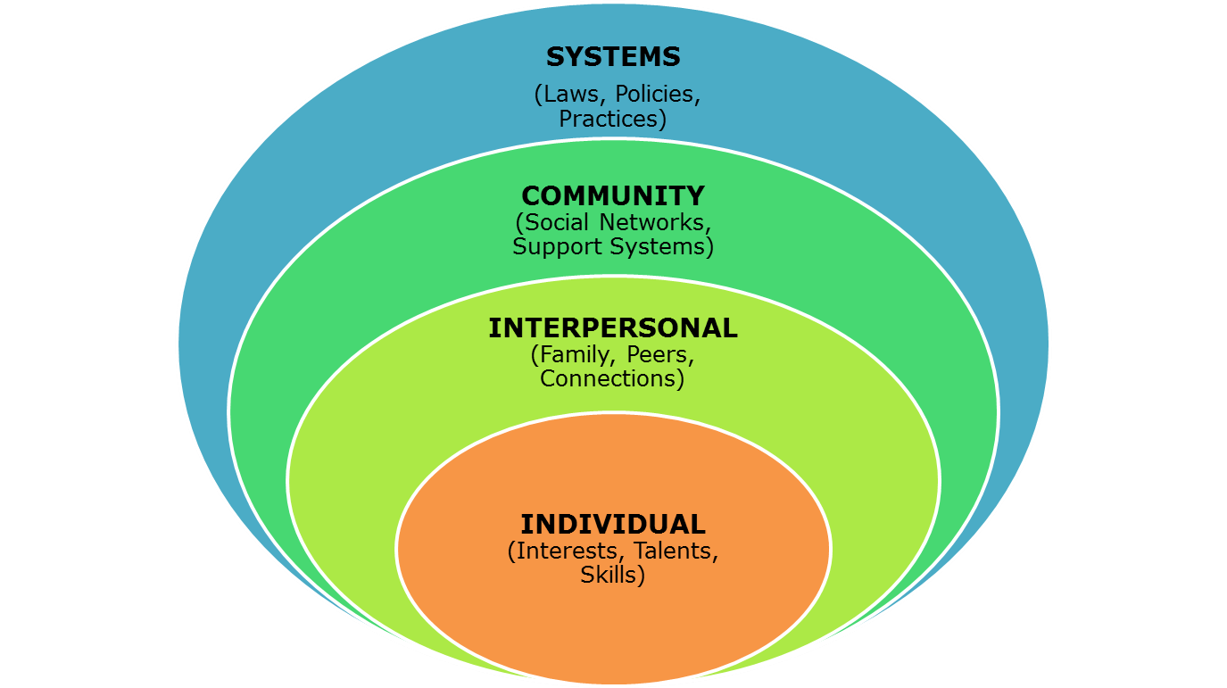
Socio-Ecological Approach
Acknowledges the complex interplay between a person and his/her environment
Notes:
This model of customized employment process is grounded in social-ecological theory in that it acknowledges the complex interplay between a person and the environment. It emphasizes the importance of person-environment fit as well as the diverse systems that influence human functioning. It takes into consideration the unique aspects of each person such as the person’s age, disability, functional capacities, disposition, and interaction style while also recognizing contextual factors such as living arrangements, geographical location, support systems, connections, and resources to help facilitate an employment outcome that aligns with the individuals interests and talents while considering conditions that may impact successful, long-term employment

Slide 39
CE Process
Job Seeker
Discovery Process
Comprehensive assessment of interests, skills, and conditions for employment
Vocational Profile
A robust, strengths-based narrative of the job seeker that translates discovered interests and skills to potential employment opportunities
CE Planning
Employment blueprint developed with input from all team members: job seeker, family, friends, CE provider, and other service/support providers
Portfolio/Visual Resume
Video/photo resume may be used to illustrate job seeker’s ability to provide essential elements of a job
Job Development & Negotiation
Work with employers to identify their unmet needs and customize job opportunities that will benefit from job seeker skills
Accommodations & Supports
Environmental restructuring, training, and customization to enhance job seeker success and retention
Notes:
This figure illustrates the customized employment process. The job seeker is at the center of the process and should always be involved in every aspect of his or her vocational rehabilitation. This customized employment process begins with Discovery and proceeds through the steps to employment and post-employment supports that facilitate job retention. This is not a linear process. For instance, Discovery will continue to take place throughout the process and the vocational profile is ever evolving to reflect newly obtained skills, interest, and support needs.

Slide 40
The ACCESS Intervention
Protocolizes the CE process
User-friendly system
Standardized, consistent method of delivery
Fidelity checklist
Establish an evidence-base
Generalizability
©
Notes:
ACCESS protocolizes the CE process within a user-friendly system that incorporates an interconnected package of tools, templates, and logs that promote consistent application of the intervention. Elements from a myriad of popular CE models and feedback from stakeholder groups were referenced in the development of the ACCESS intervention. The model is further informed by The Essential Elements of Customized Employment for Universal Application (2017), a document developed by leaders in the field and published by the Workforce Innovation Technical Assistance Center (WINTAC).

Slide 41
Customized Employment Models
ACCESS- Achieving Competitive, Customized Employment through Specialized Services
6 Key Elements:
Discovery process
Vocational profile
CE planning meeting
Portfolio/visual resume
Customized job development and negotiation
Accommodations and Post-employment supports
Notes:
As stated ACCESS is described as “protocolizing” the CE process with individuals with autism.
It uses these 6 key elements: Discovery Process, Vocational Profile, CE planning meeting, Portfolio/visual resume, Customized job development & negotiation and Accommodations and post-employment supports.
Fidelity instrument- Benchmarks of Quality Checklist (BQC) is used to assist with training in ACCESS, monitor adherence to ACCESS model and to document omissions, additions and adaptations that are made during implementation for each consumer.
Other CE demonstration projects showing 4-6 months and with this population it is 8-9 months.

Slide 42
Activity Logs
Discovery Benchmark :
Initial interview = 3.5 hours (n=8)
Observations in the home = 2.8 hours (n=6)
Familiar activities = 4.7 hours (n=6)
Novel activities = 7.5 hours (n=5)
Average time in Discovery = 27.7 (n=5)
Notes:
A review of the Discovery logs in their research showed that the full Discovery process occurred with average of 27.7 hours. Ample time was spent on observations across activities and settings.

Slide 43
Benchmarks of Quality Checklist
©
Fidelity measure
facilitate training and guidance for community-based providers who implement the ACCESS intervention
promote adherence to the ACCESS model
document omissions, additions, and adaptations that are made during the implementation process
Notes:
The Benchmarks of Quality Checklist (BQC) is a fidelity measure has been developed to 1) facilitate training and guidance for community-based providers who implement the ACCESS intervention; 2) promote adherence to the ACCESS model; and 3) document omissions, additions, and adaptations that are made during the implementation process.

Slide 44
Results/Findings from Open Trial
Primary outcome = Competitive, integrated employment
4 participants completed the ACCESS intervention
ALL 4 attained competitive employment (note – one of the 4 enhanced employment with increased hours)
Employment Type & Average Hours Per Week (hpw):
Self-employment (Game developer contract); 25 hpw
Self-employed (Health & Wellness); 17.5 hpw
Financial Accounting; 40 hpw
Hotel position – (later turned down for personal reasons)
Notes:
Although the research data to date is limited additional studies are underway and findings to date are quite promising.
After several participants withdrew from the study and based on information obtained through qualitative interviews (by unbiased scientists) with these participants, we have added a work motivation assessment that includes the participant’s definition of a successful outcome. It seems that the motivation for participating was not intrinsic for a couple of the participants but, reported in post interviews as being influenced by family members.
There was also a challenge with one community provider in that 5 participants only met with this person 1-2 times and then dropped out indicating there was not a good fit between provider-consumer. This had large implications to original study sample size.
Demonstration projects indicate the typical timeframe for the CE process is 4–6 months. This team learned that the average time is closer to 8-9 months for individuals with ASD. This is due, in part, to complexities that extend the time needed for a robust Discovery process.

Slide 45
Implications for Policy & Practice
Need an evidence-based, user-friendly CE process for consistent implementation of CE services across states as required by WIOA
Highly qualified practitioners are necessary
Turnover; caseload size; capacity issues
Job retention services need to be included
FOCUS SHOULD BE ON BUILDING A BETTER SYSTEM!
Notes:
Success of the ACCESS study, and other CE projects, is greatly impacted by provider agencies and practitioners. Highly qualified, well-trained practitioners are necessary for successful implementation. High turnover in provider agencies paired with large caseloads/capacity issues are ongoing issues – particularly when serving individuals with autism who require more time and attention..
This group found that successful integration of CE strategies into the VR system will require involvement by all stakeholders (individuals, families, provider agencies/ practitioners, VR personnel, policymakers, etc.). A collaborative approach to training, process, documentation, and employment supports is essential to effectiveness and sustainability of the intervention.
Tammy Jorgenson and ACCESS team from their work felt there is a strong need to build a better system of services. Specifically attending to improving training, qualifications and sustainment of VR staff.

Slide 46
ACCESS Products & Resources
User-friendly, linked system for CE process
Website
FREE resources for all
ACCESS Templates & Forms
Information and training videos
For all stakeholders (job seekers, families, VR professionals)
Technical assistance available
Research Team Email Addresses:
smithtj@usf.edu
http://www.usf.edu/cbcs/cfs/academics/rmhc

Slide 47
Project SEARCH
Paul Wehman, Carol Schall and colleagues
Virginia Commonwealth University Rehabilitation Research and Training Center (VCU-RRTC)
Notes:
Funding All phases of this study were funded by the Disability and
Rehabilitation Research Project (DRRP) grant #90DP005103 from the
National Institute on Disability and Rehabilitation Research (NIDRR).

Slide 48
Project SEARCH Model
Project SEARCH is a transition-to-work internship program that uses an SE approach to assist youth and young adults with developmental disabilities acquire vocational skills It utilizes a series of internship rotations in various work settings to help the student obtain job experience and determine job preferences.
It assumes a close partnership with the business by ensuring that internship work is meaningful and productive, benefiting both the student and the business.
The program has been reported to serve individuals with a wide variety of disabilities including autism spectrum, blind/visually impaired, deaf/hearing impaired, emotional disturbance, mild, moderate, severe and profound intellectual disabilities, learning disabilities, multiple disabilities, orthopedic impairment, other health impairment, speech or language impairment, and traumatic brain injury
Go to for more information and attend this webcast: http://autism.sedl.org/index.php/webcasts/122-webcast-11
Notes:
Project SEARCH reports the program is implemented in over 400 sites internationally.
On the Project SEARCH website, they define a successful employment outcome as year-round competitive integrated employment (CIE) working for the prevailing wage at least 16 h weekly.
They report between a 92 to 93.6% completion rate and a 70.2 to 75.5% employment rate (Project SEARCH 2017).
This webcast examines the Project SEARCH Model, identified by the National Advisory Panel as an effective vocational rehabilitation program, and discusses how the New York Collaborates for Autism has adapted this model specifically for people with autism spectrum disorder (ASD). Project SEARCH is a one-year, school-to-work transition program for young people with a wide variety of intellectual and developmental disabilities, including ASD. The program lets individuals work in a business where they stay full time to learn appropriate business behaviors and skills that will help them to find and keep competitive employment. Run time: 58 minutes 20 seconds.

Slide 49
Project SEARCH Plus ASD Supports
Information from publication
Project SEARCH plus ASD Supports (PS + ASD) provides specific techniques to meet the needs of youth with ASD
New supports include:
social communication training
provision of visual cues
behavior support and self-regulation strategies
As reported by Wehman et al 2020, “one of the essential hallmarks of the PS + ASD model is the braided provision of services by educational and adult services agencies simultaneously.”
References include Schall et al. 2015; Wehman et al. 2017; Wehman et al. 2020
Notes:
Participants in PS + ASD received a mean of 206.19 h of direct instruction from project team members during their time in the three internships. Educational staff provided a mean of 113.54 h (55.07%) of the direct instructional time while job coaches provided a mean 92.65 h (44.93%) of the direct instructional time on the internship sites.
In addition to direct instruction, job coaches spent a significant amount of indirect time developing internships, working with the on-site supervisors and internship mentors, and communicating with hospital management.
Now time spent in direct instruction and supervision decreased across the
three internships as participants gained independence at work.
Note- Both the teacher and job coach also received additional training in the provision of applied behavior analytic instructional and behavior change techniques including…scored task analysis, behavioral rehearsal of social communication skills, shaping and modeling, planned structured generalization of skills between environments, functional assessment of behavioral challenges, multicomponent behavior intervention planning, and prompting and prompt fading.
In addition to the direct services team described above, each location was supported by a coordinator group composed of a school district administrator, the VR case manager, a business liaison from the hospital, and the university coordinator- meeting monthly and being thoroughly trained in model by developers (30 hrs). fidelity of implementation was monitored and verified by an independent team

Slide 50
Additional Program Elements
Many supports are in place in preparation for “graduation” and transitioning to employment.
Define the criteria for job
Develop a strategic plan for employment
Develop specialized job seeking modifications
Maintain continuity of team
Launch directly into job development post graduation
Notes:
-define the criteria of the desired job, including amount of time the individual would like to work, location near home, preferred tasks, jobs and industries, preferred shifts, etc.
-Develop a strategic plan for employment
- Develop specialized job seeking modifications. Because many of these individuals are unable to sit for interviews these modifications include collecting videos of the person working, recommendation letters from internship supervisors, and job leads from the family’s contacts. Also do “working interviews” where the applicant performs the duties of the job alongside the supervisor
- Maintain continuity of team involves a focus to continue services with the same VR case manager and job coaching agency that provided services during their PS + ASD year. So that there is a link between Pre-ETS and adult VR CIE
- Launch directly into job development post graduation. This includes Job seeking profile was completed during the internship year so students go directly into job development post graduation. If job not found immediately after graduation than into phase three, job site training, and phase four, long term supports.

Slide 51
RCT Study findings
Large multi-site randomized clinical trial (RCT), across 4 school districts and community hospital settings
Sample could be considered “moderately impaired” within range of mild to moderate
Findings:
At graduation, 32% (25/79) intervention vs 5% (2/42) control were employed
At follow-up, 73% (58/79) intervention vs 17% (4/24) control were employed
At graduation, average 19.36 h per week (SD = 6.7), hourly wage of $9.61 per hour (SD = 1.48).
At 1-year follow-up, average of 21.2 h per week (SD = 9.7), hourly wage of $9.67 per hour (SD = 1.55).
Notes:
To describe the sample more ALL participants in the study were enrolled in self-contained special education programs for the majority of their school day and working to receive a special education certificate of completion instead of a standard diploma.
6.65 times more likely at graduation (95% CI 1.65, 26.7) and 4.41 times more likely at 1 year follow-up (95% CI 1.78, 10.9) to be employed than participants in the control condition.

Slide 52
Types of Jobs
Intervention | # participants | Control | # participants
Healthcare | 26 | Foodservice | 2
Food Service | 15 | Landscaping | 2
Retail | 9
Hospitality | 7
Distributor | 5
Manufacturer/supplier | 3
Entertainment | 2
Sports/Recreation | 2
Education | 1
Facilities Management | 1
Transportation | 1
Did not gain employment by 1-year follow-up | 15
Gained employment after 1-year follow-up | 6
Decided to not pursue employment | 3
Did not complete the Intervention | 6
Notes:
Healthcare types: Clinical Associate (9)
Environmental Services Aide (5)
Central Sterile Processing Associate (3)
Information Technology Clinical Associate (2)
Utilities Aide (2)
Surgical Care Technician (1)
Unit Secretary (1)
TBI Data Entry Clerk (1)
Patient Care Technician (1)
Purchasing Associate (1)
Hospitality: Laundry Attendant (3)
Spa Assistant (1)
Domestic Assistant (1)
House Attendant (1)
Banquet Houseman (1)
Distributor: Warehouse Associate (2)
Picker (1)
Distribution Center Associate (1)
Distribution Center Health Enthusiast (1)
Manufacturer/supplier: Production Worker (1)
Package Handler (1)
Mail Sorter (1)
Sports/recreation: Custodian (1)
Housekeeper (1)
--Of those 15 (19%) subjects who never gained employment during the study, six (7.6%) did not complete the PS + ASD program due to severe behavioral challenges requiring a change in placement. Another six (7.6%) participants gained employment after the 1 year follow-up point. Finally, three (3.8%) participants chose not to pursue employment after participation in PS + ASD

Slide 53
6 Key Elements of Project SEARCH + ASD strategies leading to successful employment outcomes
Internships
Instruction
Personalized vocational assessment and training
Seamless transition to adult services
Leaving high school with a resume and examples of successful work
Focus on meeting business needs
Barriers to Implementation: Time, Cost, Staffing, Inter-Agency Collaboration, Business Participation
Notes:
Internships: Participants gained work experience through internships that either built upon their long term career goals and/or were designed to cumulatively build their employment skills and social communication behavior with the eventual goal of each participant demonstrating career readiness by the end of internship 3.
Instruction-Instructional practices provided within internship experiences were embedded in ABA techniques.
Personalized vocational assessment and training- Partnering with hospitals to allow for different types of work experiences. Participants were able to work in individually selected internships that acted as both assessment and training opportunities
Seamless transition to adult services- educational staff and job coaches daily. In addition, they had regular contact with their VR counselors. Upon graduation, they did not enter waiting lists for services with staff who did not know them. Instead, the very next day after graduation, they immediately began their job search with job coaches and VR counselors who knew them
Leaving high school with a resume and examples of successful work- Thus they relied, instead, upon alternate interview techniques, such as “working interviews,” “video resumes,” specific letters of recommendation from internship mentors and supervisors, and word of mouth recommendations among colleagues
Focus on meeting business needs- while interns were offered the opportunity to grow through the experience, they were expected to perform the job as required. These high expectations increased the quality of job skills learned.
Barriers to Implementation- requires intensive time, replication sites must coordinate with and purchase training and technical assistance for Project SEARCH from Cincinnati Children’s Hospital Project SEARCH developers. In addition, replication sites will need resources to fund staff and outfit the classroom with materials and supplies. These costs represent more upon start-up, but also continue across the life of the project. Additional training requirement for PS + ASD staff, especially in the area of applied behavior analysis instructional and behavioral practices, use of braided funding and program design, model requires a business to participate as a host site for the project. It is helpful if that site is large enough to accommodate multiple internships while allowing staff to act as mentors to interns.

Slide 54
More…
National Rehabilitation Information Center
(Many supported and funded by NIDILRR Program)
TEACCH’s internationally recognized supported employment model program for people with autism spectrum disorder (ASD) in Chapel Hill, North Carolina. Program participants receive an average of 200 hours of job coach support including assessment, job preparation, work adjustment training, on-site training, and follow-up services.
http://autism.sedl.org/index.php/webcasts/96-webcast-5
POW&R (Productive Opportunities for Work and Recreation), a community-based program providing employment services to people with autism spectrum disorder (ASD) in Delaware.
http://autism.sedl.org/index.php/webcasts/95-webcast-4.
Notes:
In addition, local organizations and businesses are trained on how to help and support people with autism become and stay employed. This is the third part of a 3-part series of webcasts featuring effective vocational rehabilitation programs identified by the National Advisory Panel. Parts 1 and 2 can be found under accession numbers O18264 and O18265. Running time: 60:00.
This webcast features POW&R (Productive Opportunities for Work and Recreation), a community-based program providing employment services to people with autism spectrum disorder (ASD) in Delaware. Through POW&R’s early start to employment, students begin to prepare for supported employment during the last eighteen months of their schooling and continue with long-term follow-up supports. Using the staff knowledge of ASD, on-site training, and matching the skills of the participant to the needs of the employer, adults with ASD can find and be successful at competitive employment. This is the second part of a 3-part series of webcasts featuring effective vocational rehabilitation programs identified by the National Advisory Panel. Parts 1 and 3 can be found under accession numbers O18264 and O18266. Running time: 30:00.

Slide 55
Webinar Training Series
Autism focused series of trainings to help VR counselors work with individuals with autism through all phases of the rehabilitation process.
Other recorded trainings in the series include:
Understanding Individuals with Autism Spectrum Conditions within VR services (ID200301) (Recorded training)
Engaging and Communicating with Individuals with Autism before, during and after the Intake Process through Eligibility Determination (ID200302) (Recorded training)
Tailoring Assessments and Individualized Plan for Employment (IPE) Process for Consumers with Autism (ID200303) (Recorded training)
Notes:
If this is your first webinar that you have attended focused on the autism spectrum know that there are 3 other recorded trainings available that will also be of value to attend. Each webinar is unique.
Read previous recorded webinar topics

Slide 56
Thank You and Reach Out
Thank you very much for your time and attention!
Please reach out anytime
Dr. Mary Baker-Ericzen can be reached at mbakerericzen@sdsu.edu

